Slide 1
Extra Features :

Slide 2
Admin Deactivate User
1
Admin Can Get Users by Status (Active / Not Active)
2
Get Product Sales
Features
3
Get Product Income
4
5
Merchants Selling a Product
6
Filter Products (Advanced Search)

Slide 3
Admin Deactivate User
🔹 Description:
•Allows an Admin to deactivate a user account.
•User can’t Buy any more
🔹 Logic Steps:
•Verify admin role
• Check if the user exists
•Set user isActive to false
🔹 Output :
•User successfully deactivated.

Slide 4
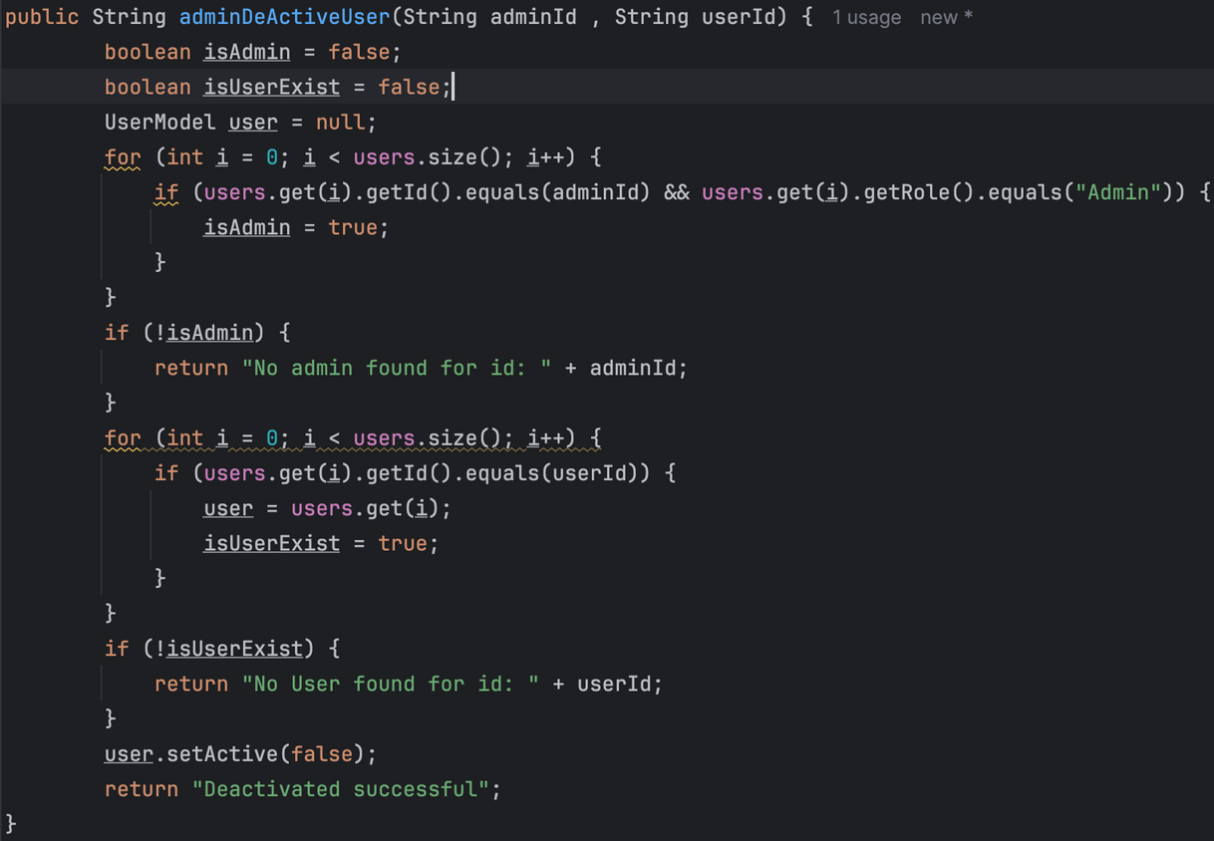
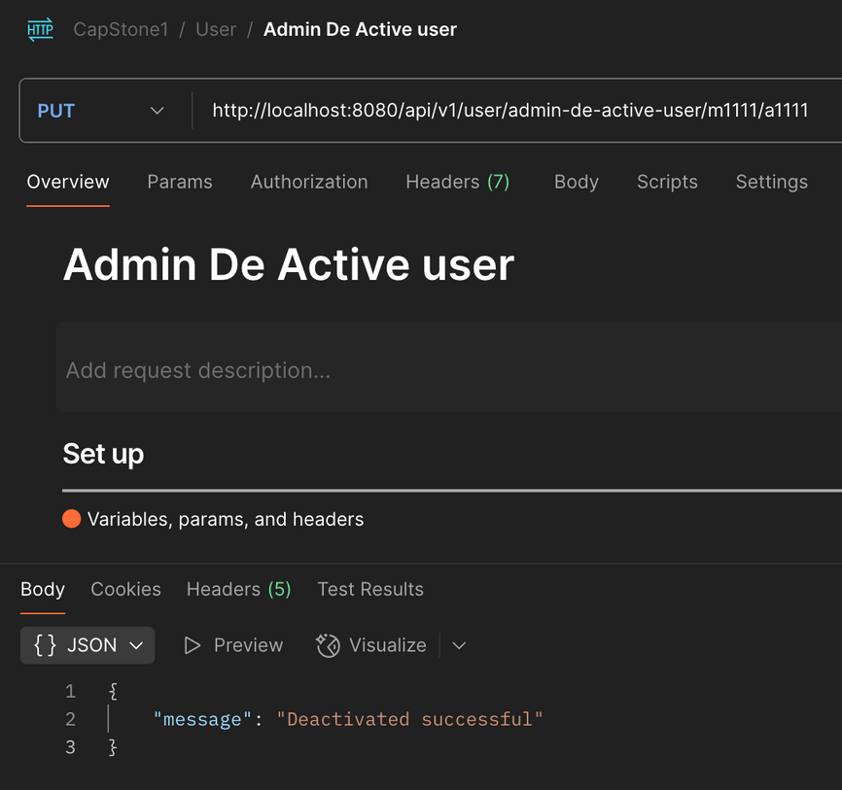

Slide 5
Get Users by Status (Active / Not Active)
🔹 Description:
•Allows Admin to view users based on activation status.
🔹 Logic Steps:
•Verify admin role
Validate the search term (active / notActive)
•Set user isActive to false
🔹 Output :
•List of users filtered by active/notActive status.

Slide 6
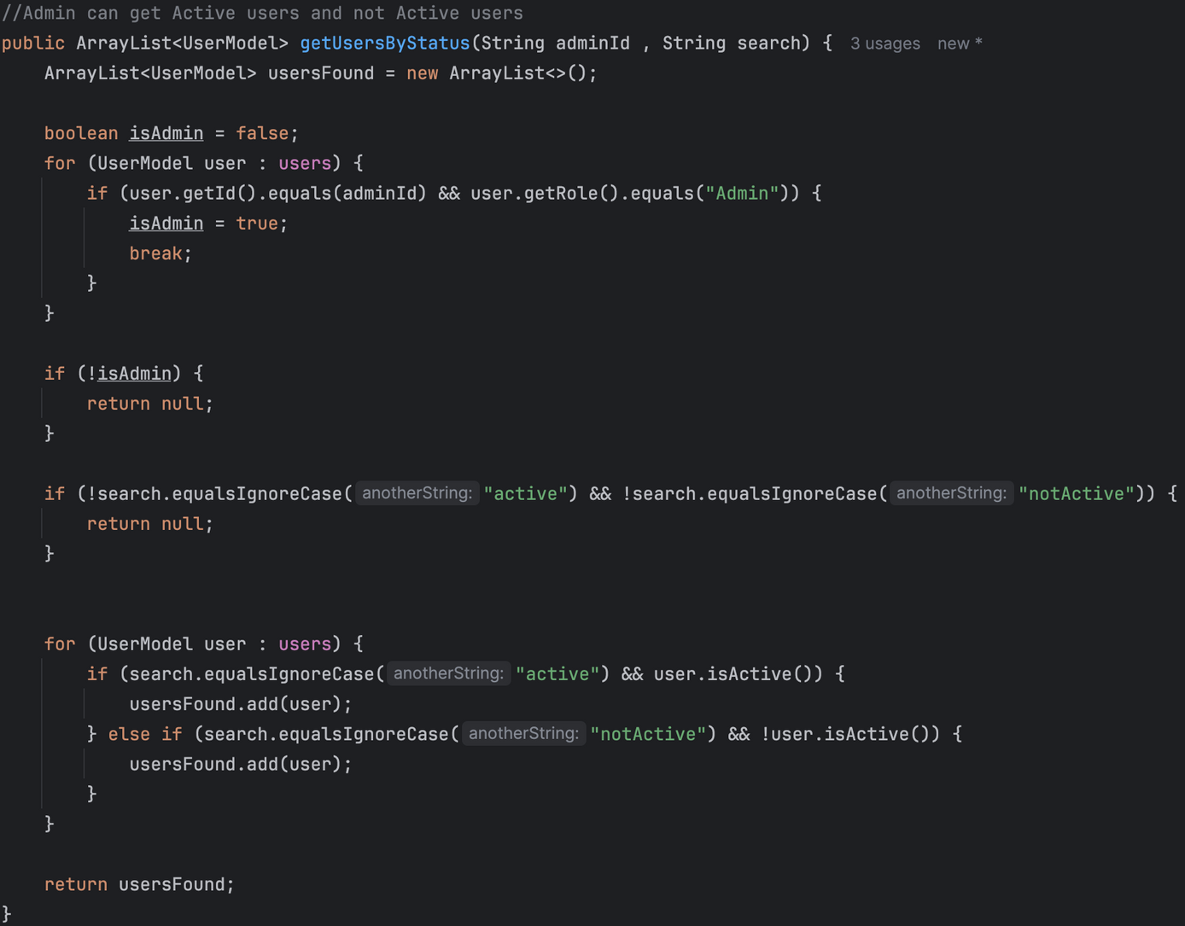
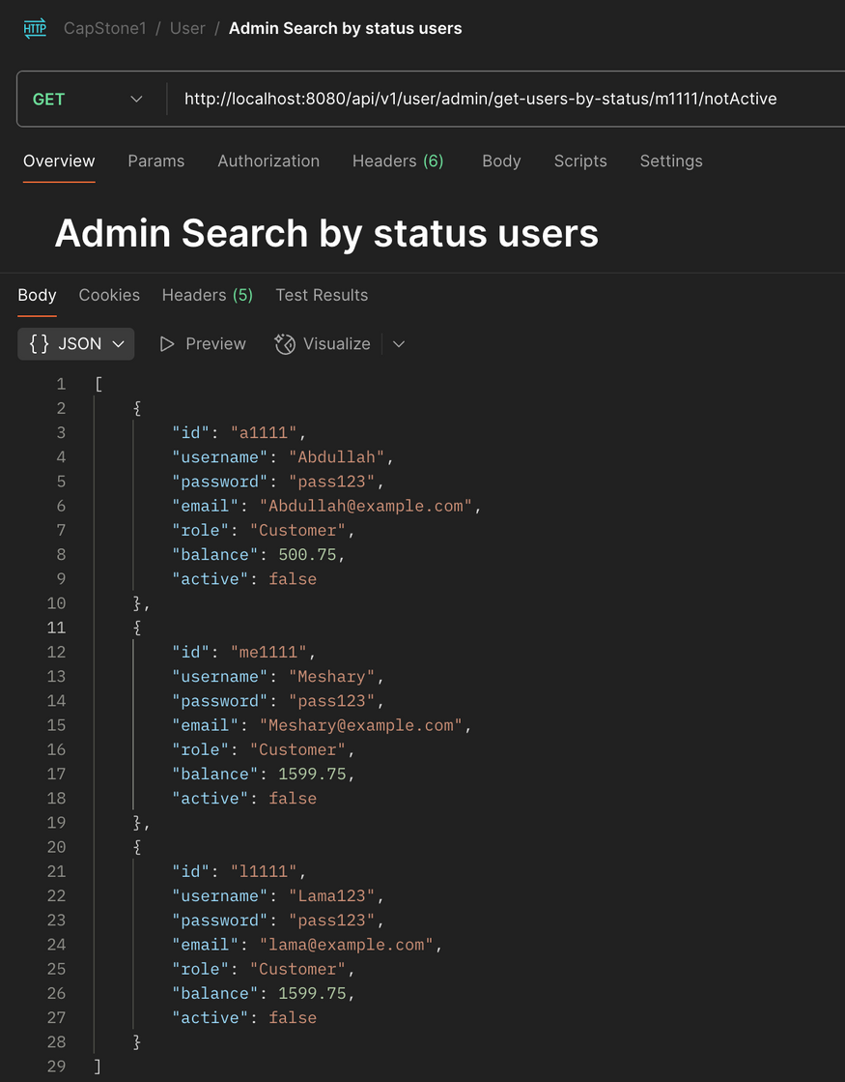

Slide 7
Product Sales & Income
•🔹 Description:
•Displays how many times a product was sold and the total income from it.
🔹 Logic Steps:
•Iterate through products
•Use soldCount and price to calculate income
🔹 Output :
•Returns number of sales and total income.

Slide 8
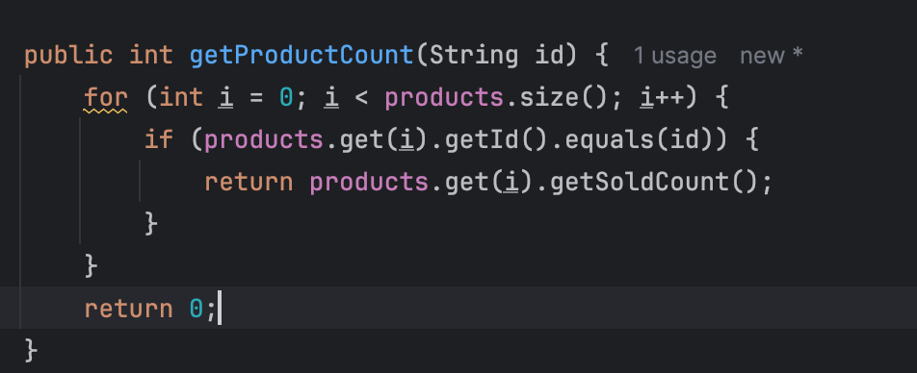
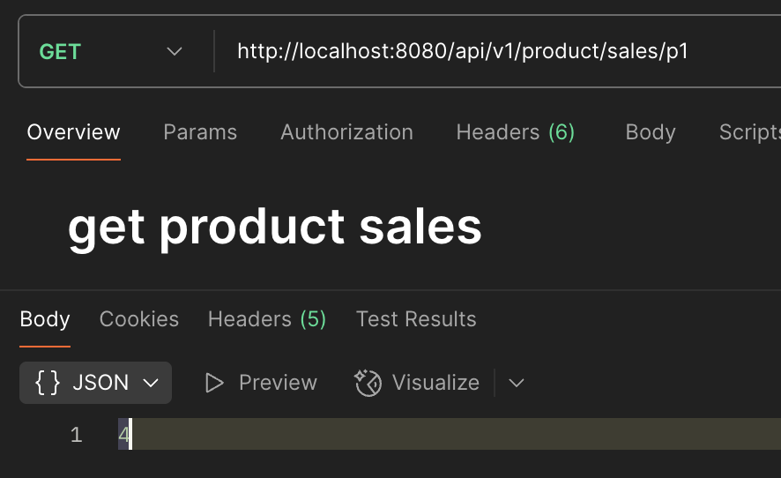

Slide 9
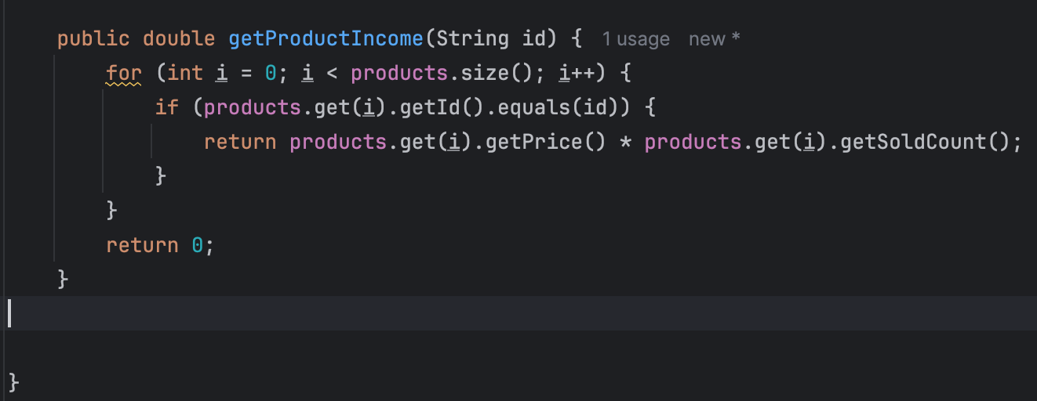
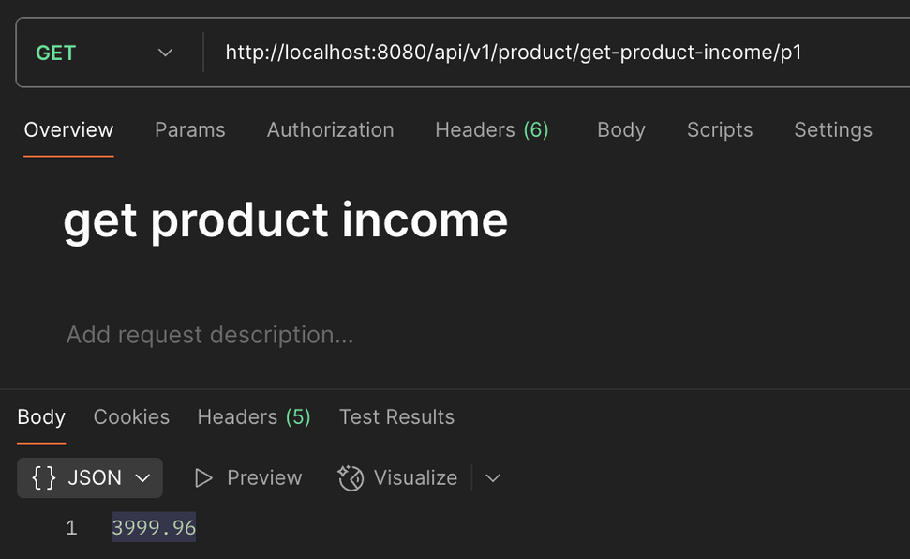

Slide 10
Merchants Selling a Product
•🔹 Description:
•Shows merchants that sell a specific product and their available stock.
🔹 Logic Steps:
•Iterate through merchant stock
•Match product ID
•Get merchant name and stock count
🔹 Output :
•List of merchants and stock per merchant.

Slide 11
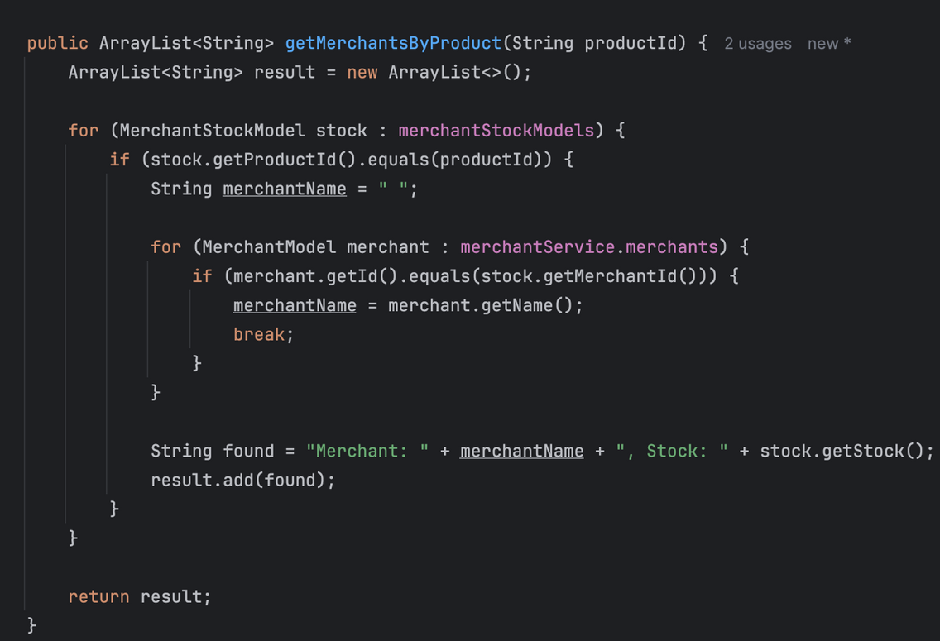
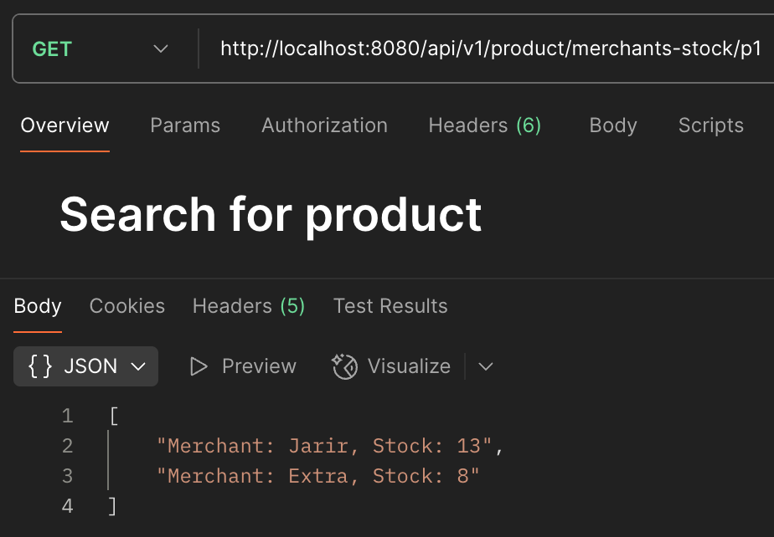

Slide 12
Filter Products (Advanced Search)
•🔹 Description:
•Filter available products based on keyword, price range, category, and merchant.
🔹 Logic Steps:
•Check stock availability
•Match name, price, category, merchent
•Add product if not already added
🔹 Output :
•List of filtered products based on search criteria.

Slide 13
